Slide 1
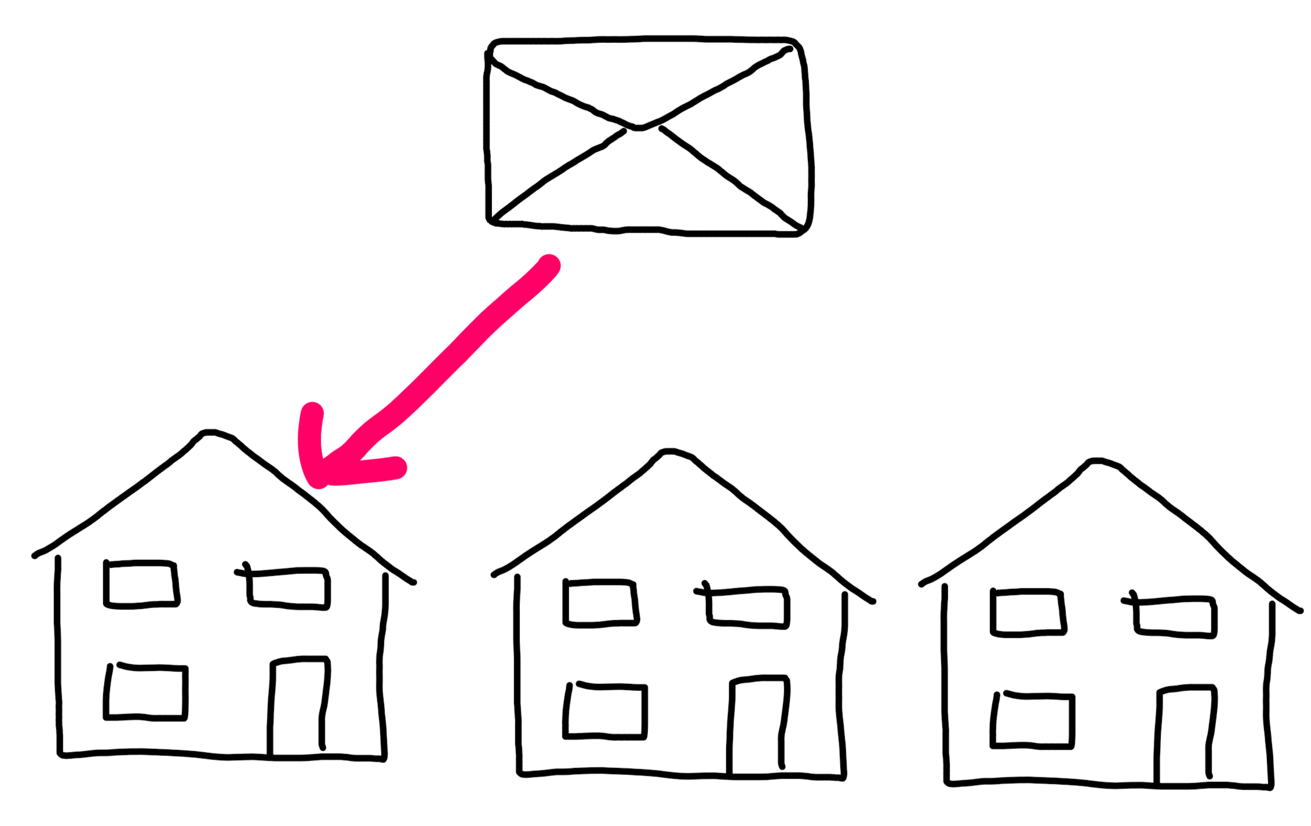
Determining department from email content using Fuzzy Logic
For our BSc project:
Fundamentals of Fuzzy Logic
Peter Heemskerk
Jim Kamans
Stefan Schenk
December 2017

Slide 2
Goal and relevance
For complex organisations it is difficult to answer email questions from customers / other parties in time.
Our goal:
use e-mail content to determine the correct department which should reply on an email.

Slide 3
Literature
Fuzzy Logic has been used for e-mail classification (spam, anti-phishing).
Main idea from Ferolin:
extract from e-mail content linguistic generalised features (like “ technical “, “ financial “, “ emotional”).
use these linguistic features as input for a fuzzy logic system to determine the departements.

Slide 4
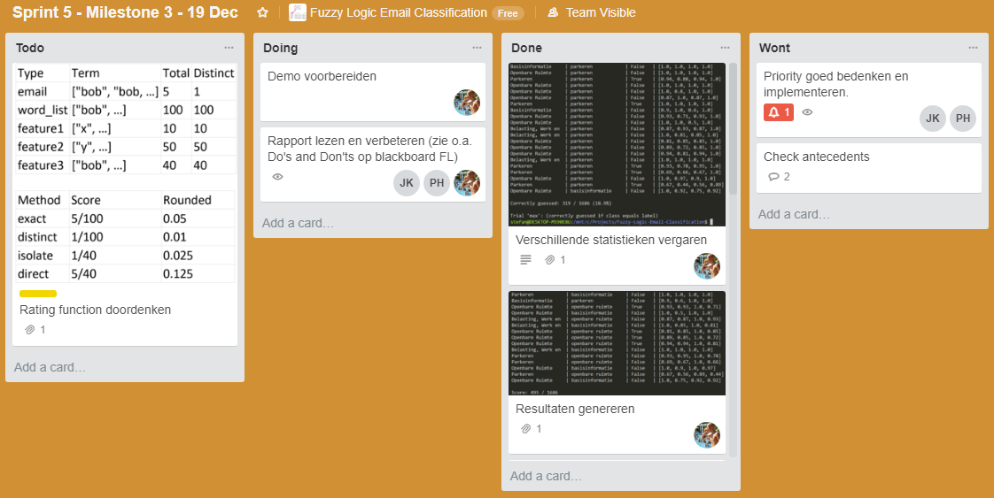
Collaboration
Stefan: code and experiments
Peter: fuzzy logic and reporting
Jim: “vliegende keep” (trouble shooting)
Collaboration with tools: Github, Trello, Google Drive

Slide 5


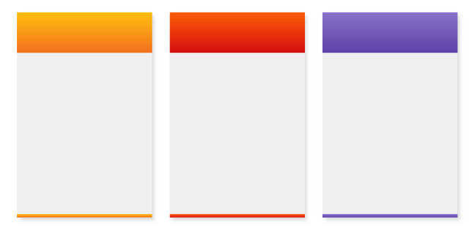

Approach
training corpus of emails
term frequency / inverse document frequency
email
e-mail content
tokenized
and stemmed
data preprocessing
data preparation
cleaned email words
feature word- lists
overlap with
feature word list
ranking
feature score
0.35
0.88
0.23
combination
of features
makes department
(fuzzy logic)
classification
department

Slide 6
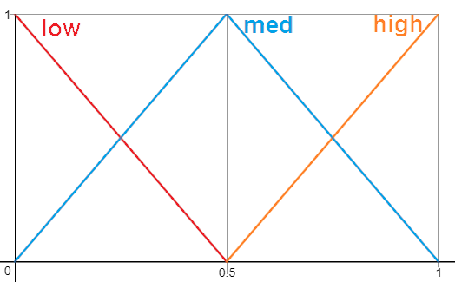
training corpus of emails
email from validation set
feature word-list preparation
data pre-processing
feature word lists (‘basisinformatie’, ‘belasting, werk en inkomen’, ‘openbare ruimte’, ‘parkeren’}
{‘handhav’, ‘rijbewijs’, ‘kopie’, … }
mfs input + output
ranking
{'basisinformatie': 0.0, 'belasting, werk en inkomen': 0.5, 'openbare ruimte': 1.0, 'parkeren': 0.3}
classification
Rules:
IF f1 = low THEN d1 = low
IF f1 = med THEN d1 = med
IF f1 = high THEN d1 = high
: : :
department

Slide 7
Data after preprocessing and Ranking
{ ‘handhav’, ‘rijbewijs’, ‘kopie’, ‘daadwerk’, … }
⇒
{‘handhav’: 2, ‘rijbewijs’:1, ‘kopie’: 1, … }
⇒
{‘handhav’: 0.0 0.0 0.2 0.0,
‘rijbewijs’: 0.0 0.0 0.1 0.0,
‘kopie’: 0.0 0.1 0.1 0.1, … }
⇒
{'basisinformatie': 0.0, 'belasting, werk en inkomen': 0.5, 'openbare ruimte': 1.0, 'parkeren': 0.3}
Notes:
FEATURES == DEPARTMENTS
Dump is split
Training is used to make feature lists
Feature lists are used to rank and classify emails

Slide 8
Implementation
[0.0, 0.5, 1.0, 0.3]
openbare ruimte
IF f1 = low THEN d1 = low
IF f1 = med THEN d1 = med
IF f1 = high THEN d1 = high
: : : :
IF f1 = low & f2 = low & … THEN d1 = high

Slide 9
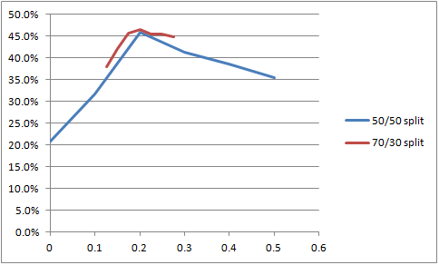
Experiments and Results

Slide 10
Results, Observations and Discussion
Accomplishments:
baseline
focus on feature word list generation
basic fuzzy logic implementation
for translating 4 features into 4 departments (feature “Parkeren” into department “Parkeren”)
score of 46% correctly classified by 70/30 split
Improvements:
extend feature baseline (based on word clustering of large email dataset)
learn fuzzy logic rules from a large labeled training dataset.

